Slide 1


Sacramento County Office of Emergency Services

Slide 2


Power Outages Happen
Make Sure You and Your Family are Prepared
What is a PSPS? It’s a Public Safety Power Shut-off, when local energy companies need to turn off power during extreme weather or wildfire conditions.

Slide 3
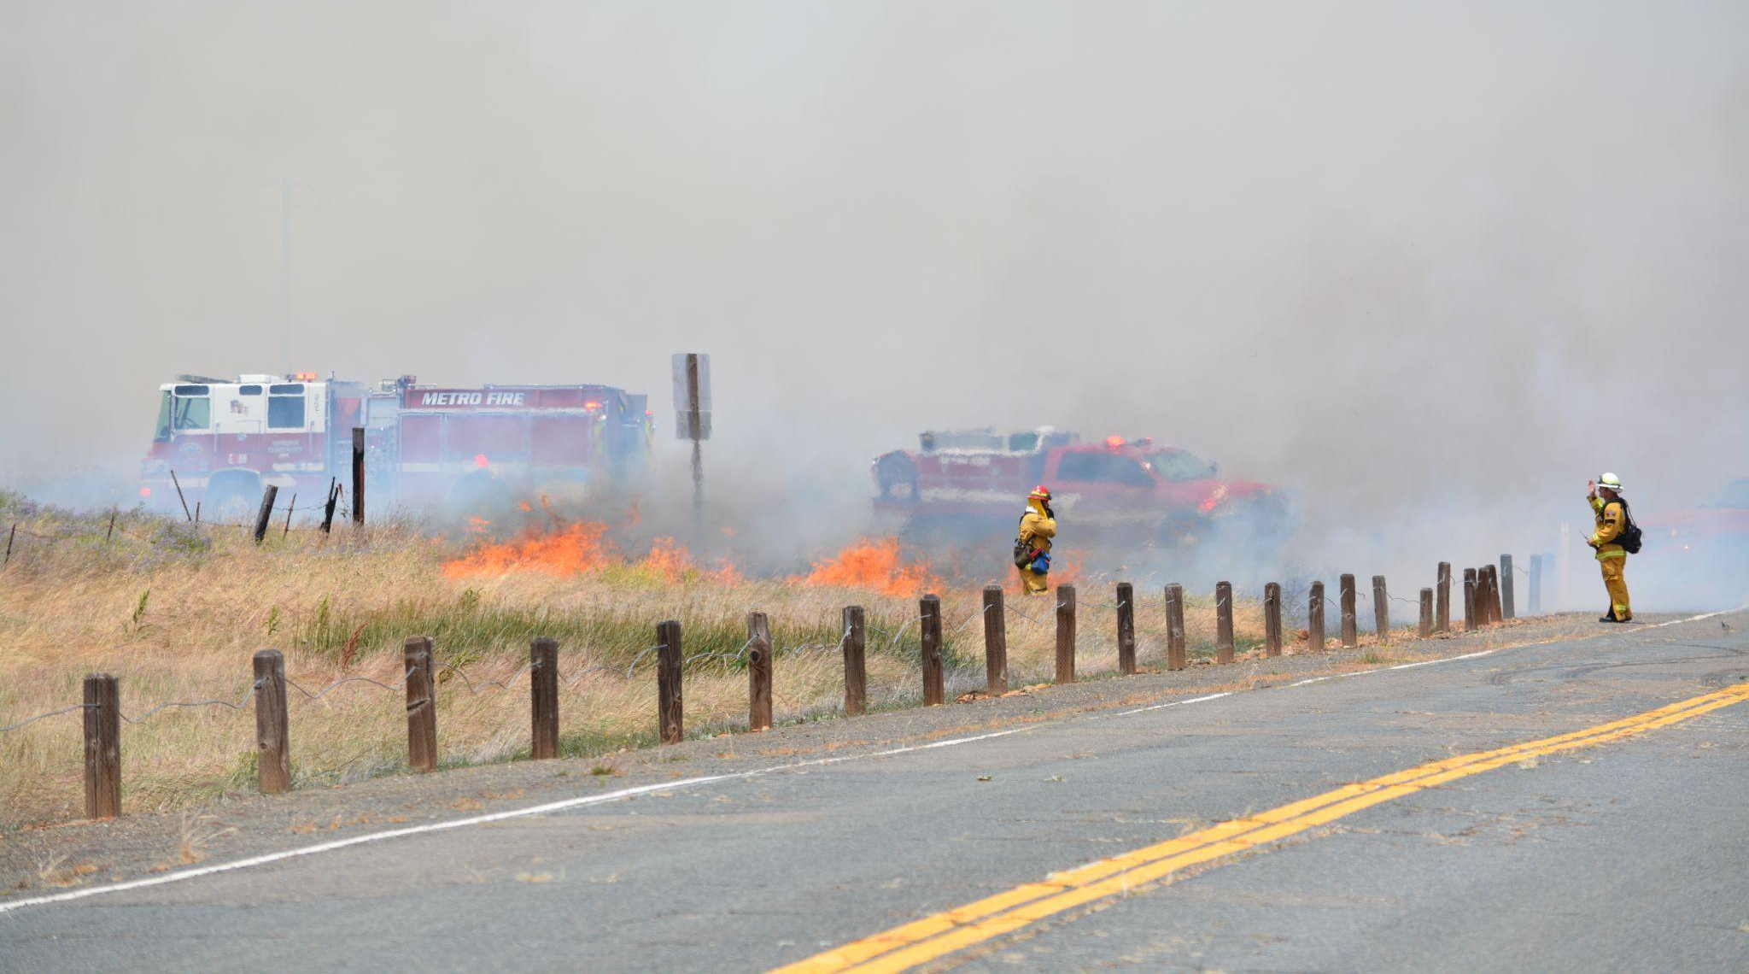

Be Proactive. Not Reactive.
Notes:
Prepare before an emergency.

Slide 4
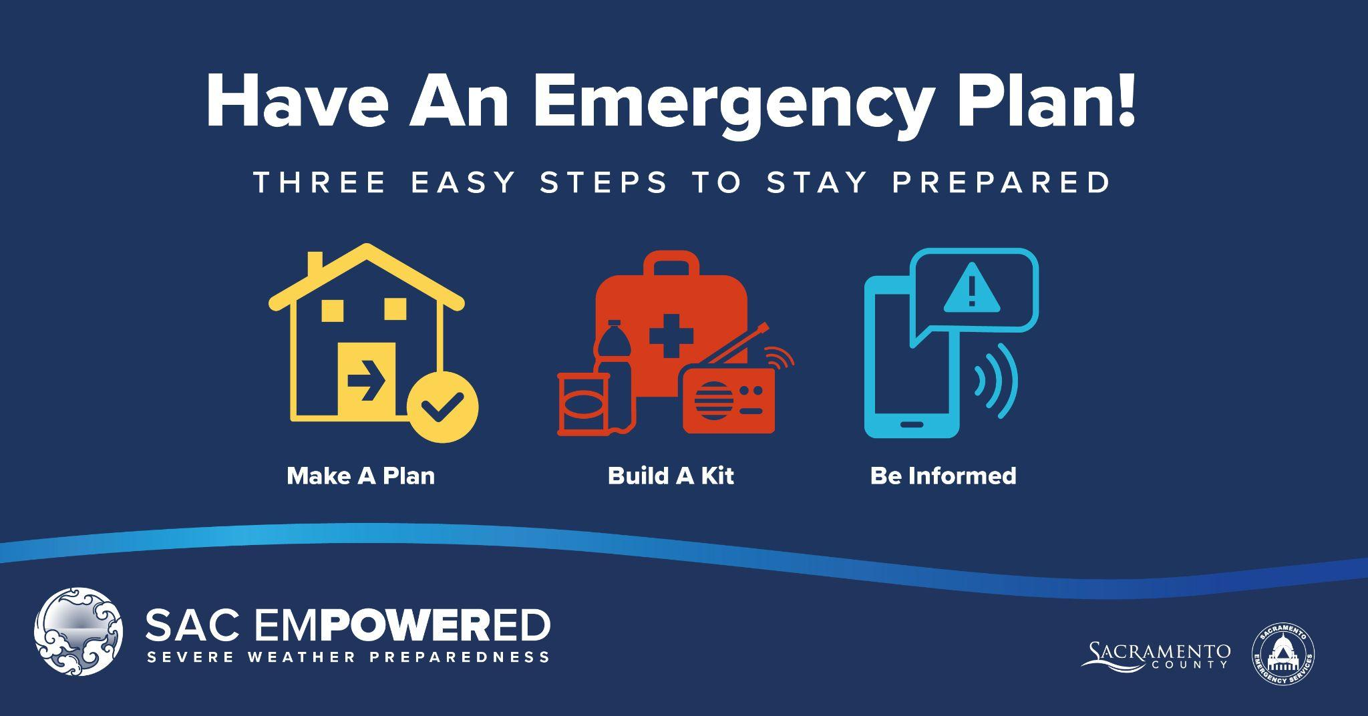
Notes:
You can find details on how to prepare at www.sacramentoready.org and I’ll talk about some key actions you can take to be prepared, stay safe and help others.

Slide 5
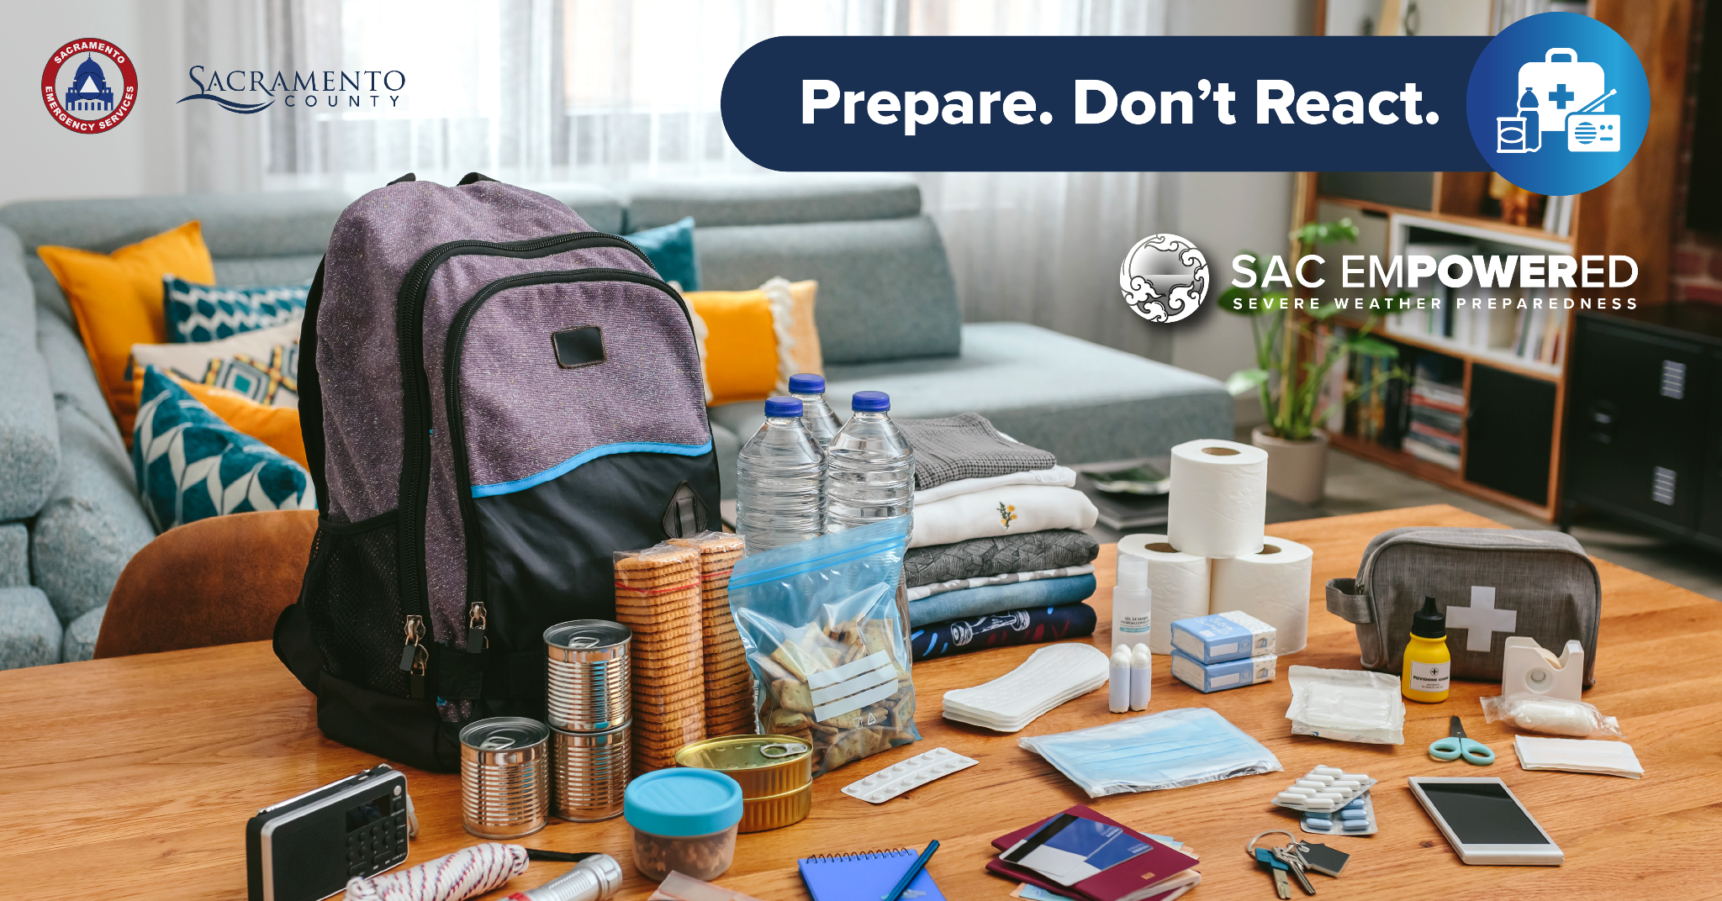
Notes:
This is an example of a disaster emergency kit.

Slide 6

No Need to Break Open the Piggy Bank
You probably have most of what you need for a Disaster Emergency Kit around your house.
Notes:
No need to purchase an expensive a pre-made emergency kit, it is easy to build one.

Slide 7
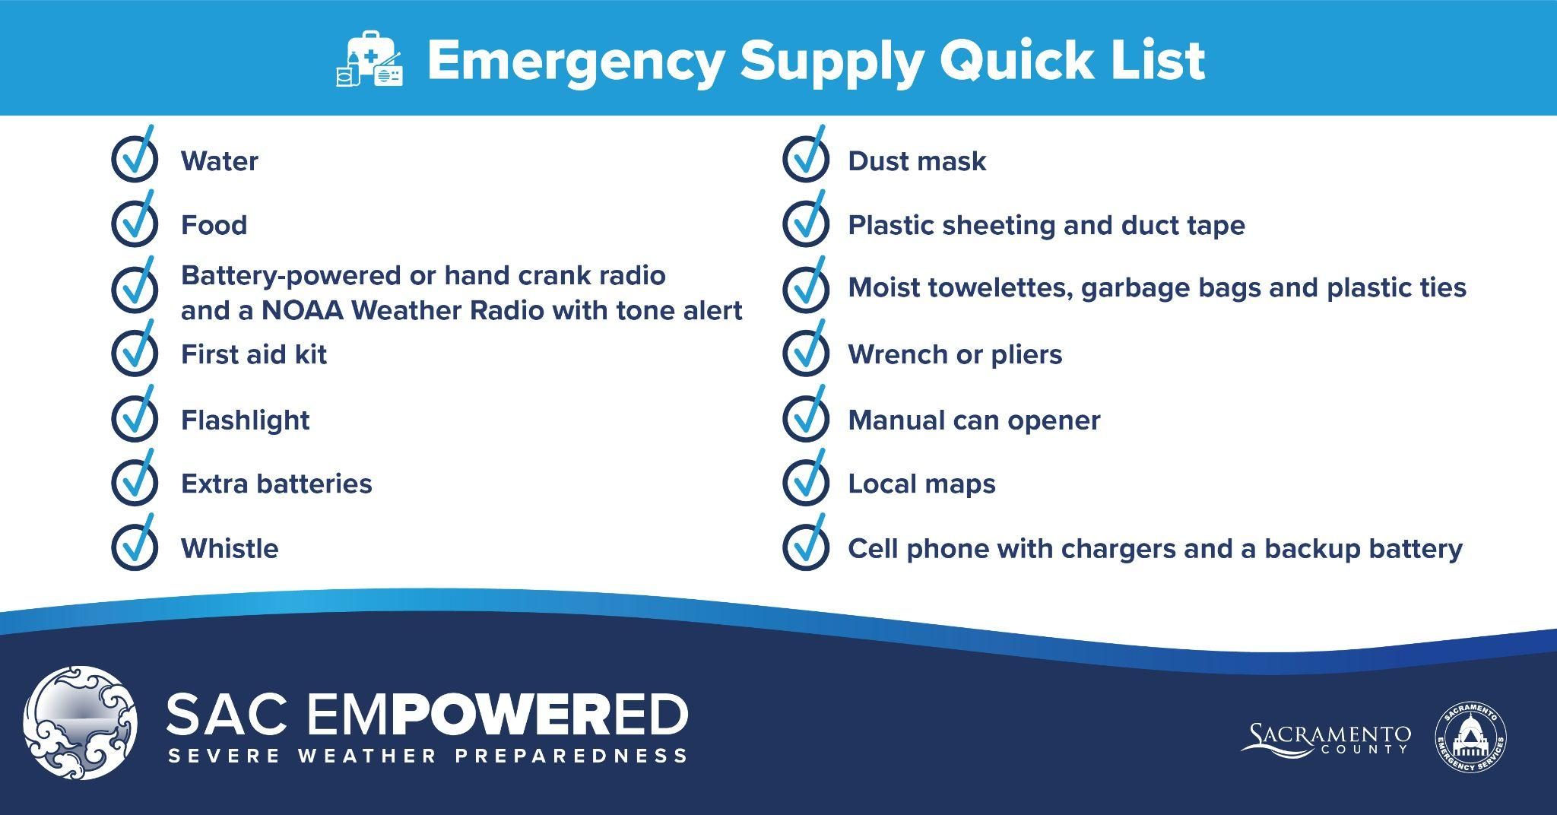
MAKE AN EMERGENCY KIT
Notes:
These are some items to include in an emergency kit. Have a three day supply of food and water per person.

Slide 8
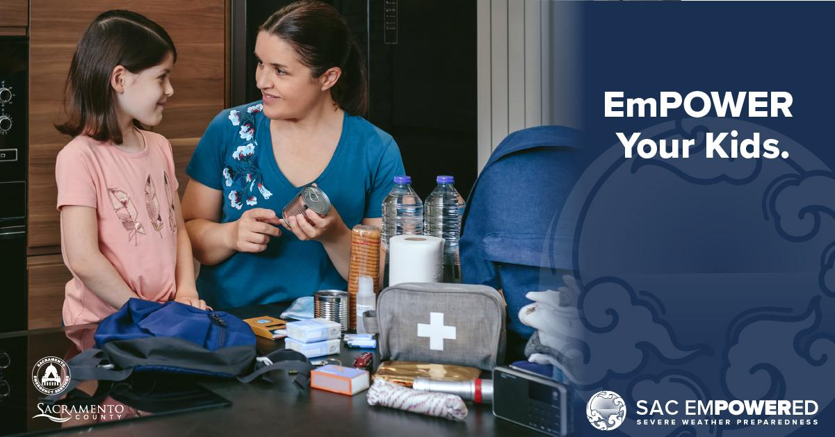
Notes:
EmPOWER your kids to help make an emergency kit to help them feel prepared.

Slide 9

Have an emergency kit scavenger hunt
Play non-electronic games for family fun and in times of power outage

Slide 10

Notes:
There are emergency kit cook off recipes available – Try one before an emergency happens!

Slide 11

Pets Are Family Too - Prepare for Them
Notes:
Pack an emergency kit for your pet with food, water, leash, litter, medications, blanket, and toys to take care of them during an emergency.

Slide 12

Notes:
Learn how to manually open your garage door so you can drive your car during a power outage. Have a 7 day supply of medications ready and a list of medications you take in your emergency kit.

Slide 13

Let your power company know if you use medical equipment
Notes:
You may be eligible on discounts through your utility company.

Slide 14
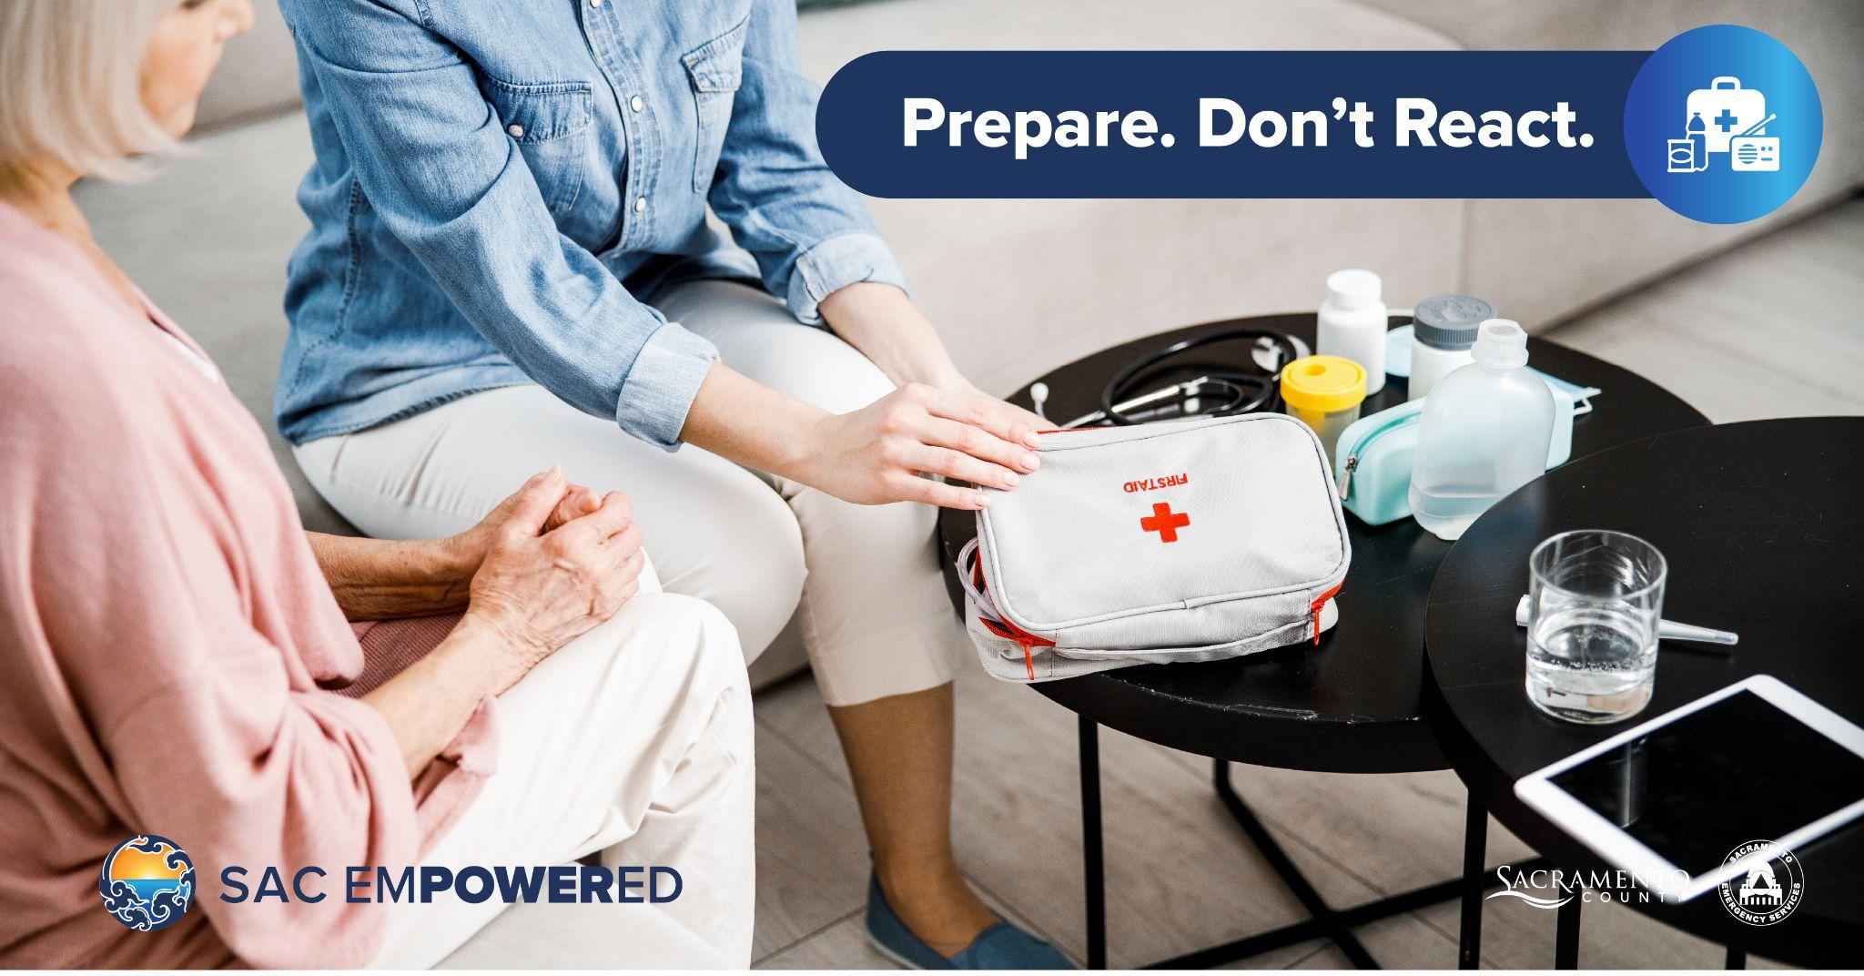
Notes:
Include first aid supplies in your emergency kit to help yourself or others.

Slide 15




@SacramentoOES
@SacramentoOES
SacramentoReady.org
Subscribe to get preparedness tips by text, email or phone.
Sacramento-Alert.org

Slide 16

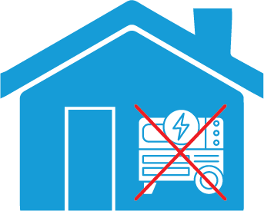
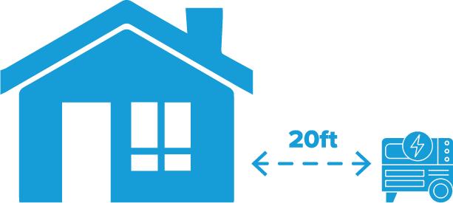
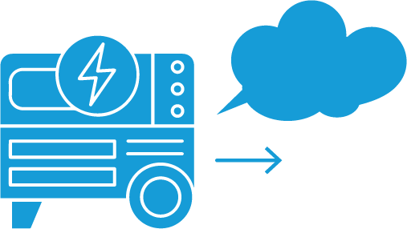
Consider using a portable power station or a generator
Safety Guidelines for Home Generators
Never Run Generators in an Enclosed Space
Always Run Generators at Least 20 Feet From Your Home
Always Direct Exhaust Away From Your Home
Notes:
Have a small charger handy to power cell phones.

Slide 17
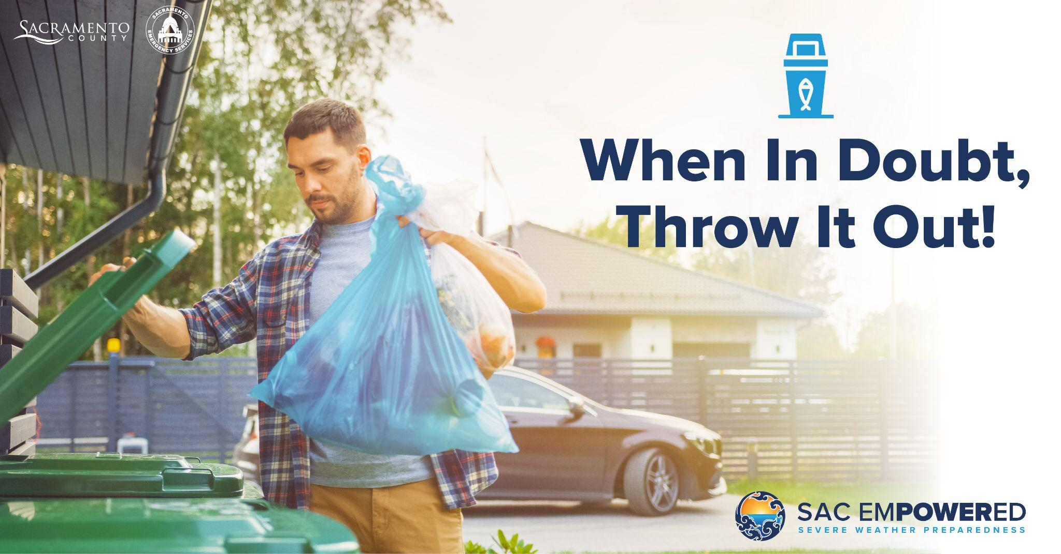
Notes:
Keep your refrigerator and freezer doors closed to help keep food cold.

Slide 18
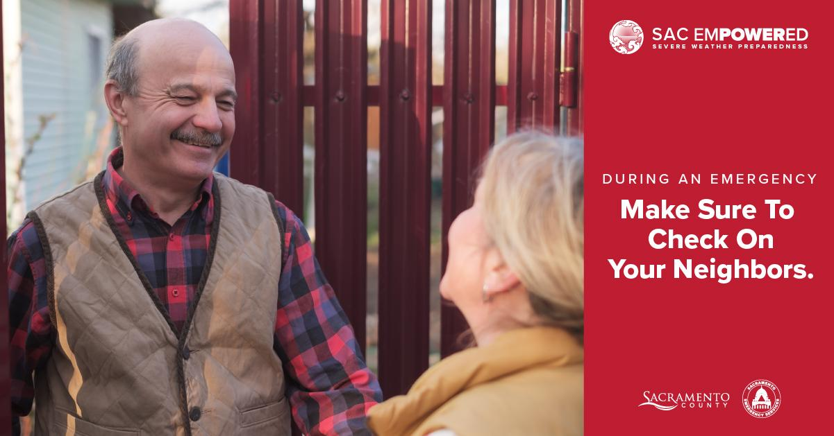
Notes:
Check on your neighbors to be sure they are safe and to offer a helping hand.

Slide 19

Be a Preparedness Superhero!

Slide 20
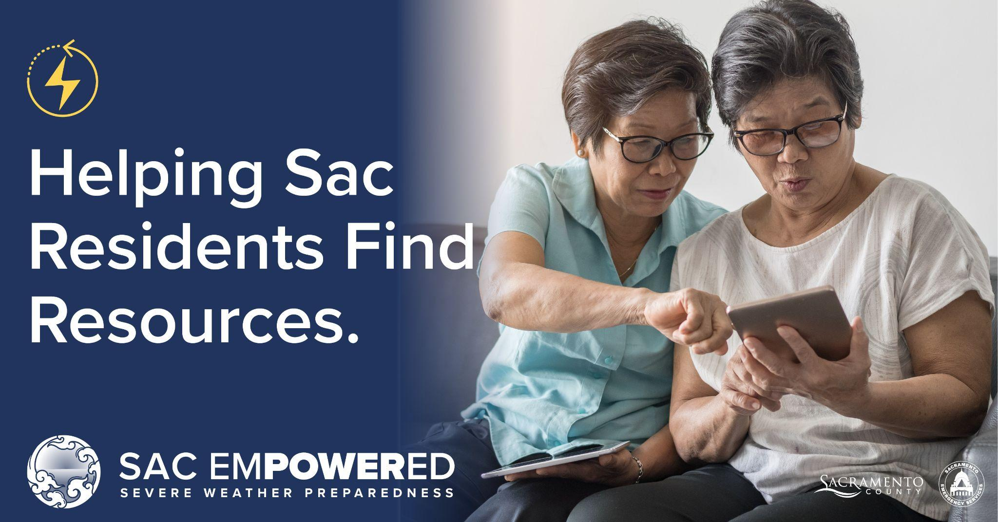
Be Prepared, Stay Safe, Help Others
For more information and resources go to:
SacramentoReady.org SacramentoOES.org

